Slide 1
MVC
-Model View Controller
Model: The backend that contains all the data logic
View: The frontend or graphical user interface (GUI)
Controller: The brains of the application that controls how data is displayed

Slide 2
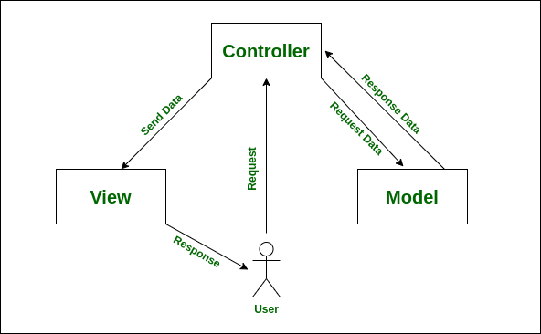

Slide 3
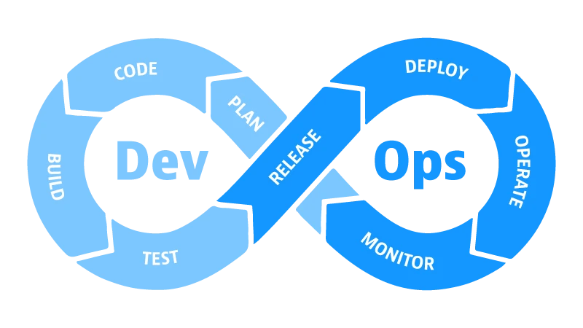

Slide 4
Deployment
Development
Production
Database-connectivity
Configuration
Testing
# Continues Deployment

Slide 5
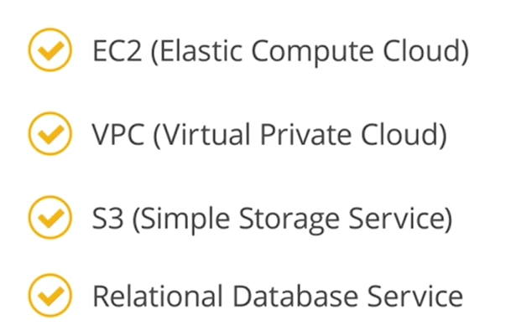
AWS
Amazon Web Services

